Slide 1



MI Options Medicare Assistance Program | State Health Insurance Assistance Program (SHIP)
Medicare 101 2026

Slide 2


Helping Seniors and Their Families
AgeWays Nonprofit Senior Services
Nonprofit with a wide variety of programs, services and supports to help older adults and their families in our 6-county region
Serve: Livingston, Macomb, Monroe, Oakland, St. Clair and Washtenaw counties
Two separate Area Agencies on Aging serving SE Michigan designated for Wayne county
800-852-7795
AgeWays.org

Slide 3



Programs That Can Help: Information and Assistance
Free phone help line for seniors and their families. Call today: 800-852-7795
See if you qualify for one of our programs or get referrals to other programs.
First place to call when you or a loved one need help.

Slide 4

For More Information
www.medicare.gov
Medicare & You Handbook
1-800-MEDICARE
MI OPTIONS MEDICARE COUNSELING-248-262-0545 (Livingston, Macomb, Monroe, Oakland, St. Clair and Washtnaw Counties)
MI Options Medicare Counseling elsewhere in Michigan-800-803-7174
SHIP Counseling outside of Michigan www.SHIPhelp.org
Notes:
For resources outside of MMAP there is The Medicare & You book which is state specific, showing specific plans for MI. You receive a hard copy each fall but can access an electronic version all year online.
Medicare.gov is Medicare’s Plan Finder and Medicare's website and of course you can call 1-800-Medicare as well.
However, the best resource for your local Medicare information is MMAP. Our services are free and unbiased. Our certified counselors are not sales agents and not affiliated with private insurance companies. We can be your best resource for all questions and concerns Medicare. No question is too small or difficult. We have saved over $2 million for beneficiaries in your area.

Slide 5

A Few Definitions
Creditable Coverage: coverage from your employer that is at least as good as what Medicare covers.
Premium: the amount you pay for an insurance policy, generally monthly
Deductible: the amount you pay for out-of-pocket costs for health care before your plan begins to pay
Co-Pay: the rate (dollar amount) you pay for prescriptions, doctor’s visits, etc.
Co-Insurance: a percentage that you pay after you meet your deductible
Cost-Share: the amount you pay out-of-pocket including deductibles, co-pays and co-insurance, but NOT premiums.
Notes:
Before we move forward, I want to go through a few definitions. You have all probably heard these terms before, and you will hear them in the rest of the presentation, so I want to be sure everyone has a good working definition to help in their understanding.
Starting on page XXX in the Medicare & You booklet, there are definitions of many of the terms you may come across. These are just some of the most important for the purposes of this presentation.
Creditable coverage is coverage that is at least as good as what Medicare provides. However, with the $2,100 cap on medications, many businesses may find that the plans they are offering no longer are “at least as good,” as they may have, for example, a $3,000 cap on medications.
To resolve this, CMS has stated that if a plan was considered creditable in 2024, it will still be considered creditable in 2025, so as to avoid a major problem. What will happen in 2026 will be determined later in the year.

Slide 6
What is Medicare?
Federally Funded Health insurance for three groups of people
65 and older
Under 65 with certain disabilities
Any age with End-Stage Renal Disease (ESRD)
Administration
Centers for Medicare & Medicaid Services (CMS)
Enrollment
Social Security Administration (SSA) for most
Railroad Retirement Board (RRB) for railroad retirees
Notes:
Some people confuse Medicare and Medicaid. Medicare is federally funded health care. Individuals work and a portion of their salaries is taken out of their paychecks for Medicare.
Medicaid is a joint federal and state program in the U.S. that provides free or low-cost health coverage to millions of Americans with limited income and resources, including children, pregnant women, elderly adults, and individuals with disabilities. As an entitlement program, it covers services often excluded by Medicare, such as long-term nursing home care.

Slide 7
When To Enroll In Medicare
6-month window to enroll without facing penalties
3 months before one turns 65 (benefits will start the 1st day of the month the person turns 65)*
The month one turns 65 (benefits will start on the 1st day of the following month)
Up to 3 months after one turns 65 (benefits will start the 1st day of the month following enrollment
*If a person’s birthday is the 1st of the month, their benefits will start the 1st day of the previous month (for example—Birthday is March 1st, benefits will start February 1st)
NOTE: Failure to enroll on time may result in life-long penalties—however, if one has “creditable coverage” for example because they are still working, they may be eligible to delay enrollment
Notes:
If you are going to continue to work past the age of 65, it is advisable to touch base with a SHIP counselor to make sure you are not going to incur penalties. Additionally, depending on the number of employees at your company, you may be required to take Part A and/or B. More will also be discussed about this further on in the presentation
*If your birthday is on the 1st of the month, your benefits will start the 1st day of the previous month. For example, if your birthday is March 1st , our benefits will start on February 1st. .

Slide 8
How to Enroll in Medicare
Enrollment is not automatic
If not getting Social Security (or RRB benefits)
For instance, actively working
Enroll with Social Security
Visit local office
Call 1-800-772-1213
Online at ssa.gov
Automatic Enrollment
If one is getting Social Security
For example if they are on disability
Notes:
It is quick and easy to sign-up for Medicare on-line.
While Medicare is administered by the Centers for Medicare & Medicaid Services (CMS), the Social Security Administration (SSA) is responsible for enrolling most everyone in Medicare
The Railroad people in Medicare. The Railroad Retirement Board (RRB) is responsible for enrolling railroad retirees in Medicare. However, you do not need to take Social Security to get Medicare
If you are not currently taking Social Security or Railroad Retirement Board benefits (for instance, because you are still working), you may need to still sign up for Part A.and/or B as Medicare has strict rules on who pays first based on the number of employees at your workplace. This will be discussed in more depth later

Slide 9

Welcome to Medicare
First mailing one will get from Medicare
Includes a letter, a small booklet and Medicare card
It’s sent to people who:
Go to SSA to sign-up for Medicare
First sign up for SSA retirement benefits (age 65 or older)
Automatically get Medicare with less than 3 months before coverage starts (usually people under 65 with certain disabilities)
It will generally arrive 2 weeks after signing up for Medicare or Social Security (if disabled, 2 weeks after SSA approves your benefits)
Notes:
It takes a few weeks for Medicare to process your application. After it does, you will get a “Welcome to Medicare” packet.

Slide 10
Medicare Card
Front
Keep it and accept
Back
Return it to refuse Part B
Follow instructions
Medicare Parts A and B
on back of card
Notes:
The Original Medicare Card is red, white, and blue, and it is used when you get health care. The Medicare card shows the Medicare coverage Part A and Part B date the coverage starts.
The Medicare card also shows your Medicare claim number.
If you choose another Medicare health plan, your plan may give you a card to use when you get health care services and supplies.
You should contact Social Security, if any information on the card is incorrect.
If you don’t want Part B, for example if you are still working and have creditable coverage, follow the directions and return the card.

Slide 11
The Four Parts of Medicare
Part A
Hospital Insurance
Part B Medical Insurance
Part C Medicare Advantage (HMOs and PPOs)
Part D Medicare Prescription Drug Coverage
Notes:
Medicare has four parts:
Part A is Hospital Insurance
Part B is Medical Insurance
Part C is Medicare Advantage which are plans like HMOs and PPOs
Part D is Medicare Prescription Drug Coverage
This presentation will take you through all four parts.

Slide 12
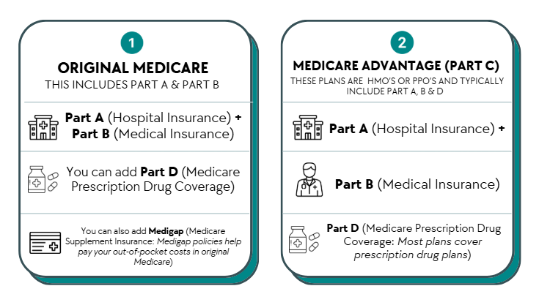
Your Medicare Choices
Notes:
When you first enroll in Medicare and during certain times of the year, you can choose what type of Medicare coverage you want-specifically, there are two paths one can go on for Medicare services.
Original Medicare:
Original Medicare includes Medicare Part A and Part B.
If you want drug coverage, you can join a separate Medicare drug plan (Part D).
To help pay your out-of-pocket costs in Original Medicare (like your 20% coinsurance), you can also shop for and buy supplemental coverage. Medigap plan
Can use any doctor or hospital that takes Medicare, anywhere in the U.S.
Medicare Advantage (also known as Part C):
Medicare Advantage is an “all in one” alternative to Original Medicare. These “bundled” plans include Part A, Part B, and usually Part D.
Plans may have lower out-of-pocket costs than Original Medicare.
In some cases, you’ll need to use doctors who are in the plan’s network.
Most plans offer extra benefits that Original Medicare doesn’t cover—like vision, hearing, dental, and more.

Slide 13


Original Medicare (Parts A &B)
Has Part A: Hospital Insurance
Hospital inpatient care
Skilled Nursing Facility
Home health care
Hospice care
$1,736 deductible (2026)
Has Part B: Medical Insurance
Doctor’s visits
Outpatient hospital services
Clinical lab tests
Durable Medical Equipment
Preventive services
$283 deductible (2026)
$202.90 monthly (2026)
NOTE: Original Medicare DOES NOT cover vision, dental or hearing, or medications
Notes:
Medicare Part A, hospital insurance, helps pay for medically necessary services. It is premium free for people who have worked the equivalent of 40 quarters (10 years where Medicare taxes were paid. Those who have worked less can buy into the system, however the price is very high ($565 a month)
Hospital inpatient care - Semi-private room, meals, general nursing, and other hospital services and supplies, including in-patient psychiatric care.
Skilled nursing facility (SNF) care (not custodial or long-term care-Medicare generally does not cover these services) when certain conditions are met.
Home health Care, skilled nursing and/or rehabilitative (PT/OT) care
Hospice Care
Blood as an inpatient
Medicare Part B covers a number of medically-necessary services and supplies.
Doctors’ Services
Outpatient Medical and Surgical Services.
Home Health Care Services
Durable Medical Equipment
Preventive Services like exams, lab tests, screening and shots to help prevent, find, or manage a medical problem. Preventive services may find health problems early when treatment works best.

Slide 14

What is Part D?
Optional Medicare prescription drug coverage
Provided by private insurance companies
You must choose and join plan
Plans have formularies (lists of covered drugs)
You pay the drug plan a monthly premium
You may have deductibles and copayments
Notes:
While technically, Part D is optional, in most cases, there are penalties to not getting it timely. That said, there are plans with low to no monthly premium. These plans are good choices for people who don’t take any prescription medications.
Part D is one of the most complicated Part of enrolling in Medicare. It involves researching plans, comparing prices and more. MMAP counselors are trained to assist you and take the stress out of enrolling.
People with limited income and resources may be able to get Extra Help to help pay for their Medicare drug plan.

Slide 15
Joining a Part D Plan
New to Medicare
7 month initial enrollment period
Annual fall open enrollment
October 15 – December 7
Coverage starts January 1
Special Enrollment Periods
Low income, involuntary loss of credible coverage, moved outside of plan’s service area, etc.
Ways to join
Call us 248-262-0545
Call the Plan directly
Visit Medicare.gov
Call 1-800-Medicare
Notes:
You can join a Medicare Prescription Drug Plan when you first become eligible for Medicare, which begins 3 months before your first entitlement to both Medicare Parts A and B. After you enroll in a Medicare Prescription Drug Plan you must remain with that plan for the rest of the calendar year.
You can change your Part D plan every year plan during Medicare Annual Open Enrollment from October 15 – December 7.
We encourage you to make an appointment every year during Annual Open Enrollment for a “benefits check-up” to make sure you are still on the right plan, as your medications may change, and/or the plan’s formulary or prices may change.
While switching plans is easy and a counselor can make this a very smooth process

Slide 16
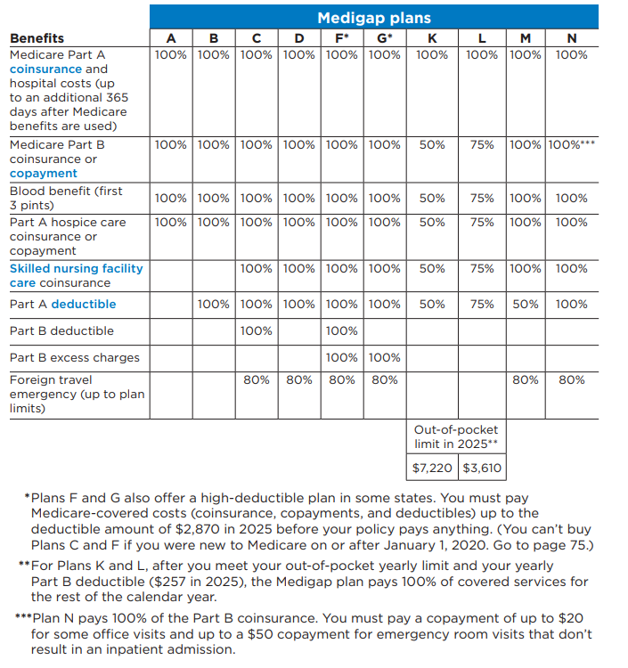
What is Medigap?
Policies sold by private companies
Fills the gaps in Original Medicare
Deductibles, coinsurance, copayments
All plans with same letter have same coverage
Costs are the major difference
Not all plans are offered to people under 65 with a disability
Notes:
Medigap (Medicare Supplement Insurance) policies are private health insurance that cover the policyholder. They are sold by private insurance companies to supplement Original Medicare (help pay for “gaps” in Original Medicare coverage - like deductibles, coinsurance and copayments)
They pay for Medicare-covered services provided by any doctor, hospital, or provider that accepts Medicare
Some Medigap plans are now offering riders or discounts for services such as vision, dental and hearing. These riders come at a cost to the beneficiary and also come with various restrictions.
It is important to note that all plans with the same letter must offer the same services at the same percentages. This is aside from any riders they may choose to offer.

Slide 17
Part C Medicare Advantage
What is Medicare Advantage?
Health plans approved by Medicare (PPOs and HMOs) run by private Insurance Companies
Includes Parts A & B and usually Part D
Medicare pays amount for each member’s care
Many plans include dental, vision, hearing, fitness and/or over-the-counter $
May have to use network doctors or hospitals
Notes:
Medicare Advantage is also called Part C. They are
Health plan options approved by Medicare
Run by private companies
Either an HMO or a PPO
Medicare pays a certain amount for each member’s care (called a capitation rate
Advantage plans are another way to get Medicare coverage
You may have to use network doctors or hospitals although most PPOs have an out-of-network option. Costs may be slightly higher than the in-network option
In addition to Vision, Dental and Hearing, some plans offer a fitness option, medically necessary transportation and other benefits.

Slide 18

Joining a Part C Medicare Advantage Plan
During 7-month initial enrollment period
Can join, drop or switch to another MA plan or Original Medicare (and add a Part D) during Annual Fall Open Enrollment
October 15 – December 7 each year
Coverage begins January 1
or during Medicare Advantage Open Enrollment
January 1-March 31 of each year
Coverage beings the first day of the following month
Notes:
You can join a Medicare Advantage Plan when you first become eligible for Medicare.
As with Part D, we advise that you check your plan every year to make sure your medications are still covered at a price you are willing to pay. You may find that there is a less expensive pharmacy to go to, and you will want to make sure your physicians are still accepting the plan.
Also from January 1 – March 31. You can switch to a different Medicare Advantage Plan. The coverage will become active the following month after enrollment.
You can also switch from a Medicare Advantage Plan to Original Medicare between January 1-March 31. However, you cannot change from Original Medicare to an MA plan during this period.

Slide 19
Medicare Advantage Special Needs Plans (SNPs)
SNPs or Special Plans are PPOs and HMOs that may offer more benefits (and at possibly a lower cost) to Medicare beneficiaries.
There are plans for people with lower incomes, called D-SNPs (for Dually enrolled Medicare and Medicaid beneficiaries)
There are plans for people with certain chronic conditions, called C-SNPs
Diabetes and Heart Disease, End-Stage Renal Diseases and HIV/AIDS are a few of the Chronic conditions where C-SNPs are available in Michigan
There are plans for people residing in institutions, who require a level of care provided by long term care facilities called I-SNPs
Notes:
On Medicare.gov plan finder, SNPs are also called Special Plans. The reason is that Medicare wants to insure that people at all income levels know that they are eligible for the C-SNPs if they have a qualifying chronic condition.

Slide 20
IMPORTANT!
If one is interested in a SNP, it is very important that they
educate themselves and talk to a counselor. It can be
complicated to navigate the myriad of programs and
services that are available. There are also strict rules
about applying for, and changing plans that need to be
understood and followed. If they sign-up in error, they may
find they have no coverage

Slide 21
Making a choice between Original & Medicare Advantage (MA) Plans
A SHIP Counselor can be very instrumental in helping one make a choice between Original Medicare, adding a stand-alone Part D plan and possibly a supplement, or choosing a Medigap plan.
There are pros and cons to each depending on one’s unique situation.
Examples:
Supplemental (Medigap) plans cost more up-front; however, if they are a big user of Medical care, they may end up paying more down the road for an MA plan
Most MA plans offer extras in addition to Vision, Dental, and Hearing, such as gym memberships and over-the-counter debit card.
A SHIP counselor will spend time learning about how one likes to access health care and what types of services are important to them. From there, choices become easier.

Slide 22
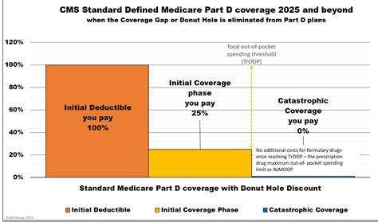
2026 Medicare Part D Phases
2026 TrOOP- $2,100.00
2026-$615
Notes:
This slide illustrates how much you will pay for your medications at various points in time. So once you pay $615, you will pay a 25% co-insurance for the cost of medications. Once you hit $2,100, you will not pay anything.
So… if you are paying a maximum of $2,100 out of pocket for your medications, who is picking up the rest of the price? The next slide will provide some detail on this
Anything about creditable coverage not being as good as Medicare, but covered anyway??.

Slide 23
IMPORTANT!
Only medications that are on one’s plan formulary count towards the $2,100 out-of-pocket. Over-the-counter drugs do not count, nor do prescription medications purchased without going through your insurance (for example, GoodRX)—even if they are on the formulary
Plan Premiums do not count towards out-of-pocket expenses
Plans may choose to not cover medications that are prescribed for “off-label” use, even if the medication is on the formulary
Notes:
For example, Gabapentin may be on your plan;s formulary for neuropathy, but your doctor may prescribe it for sleep disorders. As this drug is not FDA approved for sleep disorders, your plan may choose to not cover it or may require prior authorization. If the plan does not approve the off-label use of the medication, you will be stuck with the entire cost, and it will not cost towards your $2,100 deductible, or as part of coverage after you meet your deductible. This is just an example.
I will speak more about this a little later when we discuss weight loss drugs.

Slide 24
A Few Things to Consider For People Working Past Age 65
When the beneficiary is ready to enroll in Part B, Human Resources will have to submit CMS Form L564 and the beneficiary will have to submit CMS Form 40B to SSA confirming creditable coverage and requesting enrollment in Part B, respectively
If one chooses to take Social Security, they must take Part A. Part B can be refused as long as the coverage is creditable

Slide 25
A Few Things to Consider if You Work Past Age 65 and Enrolling in Medicare
Be aware of all relevant dates and deadlines. There are life-long penalties for enrolling late in both Part B and Part D
If covering spouse and/or dependents on employer insurance and they are under 65, they will have to get coverage through the Marketplace
If the beneficiary gets health insurance through their spouse, they will need to check with their spouse’s benefits coordinator for health insurance to ensure creditable coverage

Slide 26
Who Pays First?
If you have retiree health coverage (like insurance from your or your spouse’s former employment). . . Medicare pays first.
If you’re 65 or older, have group health plan coverage based on your or your spouse’s current employment, and the employer has 20 or more employees. . . Your group health plan pays first.
If you’re 65 or older, have group health plan coverage based on your or your spouse’s current employment, and the employer has fewer than 20 employees. . . Medicare pays first.
If you’re under 65 and have a disability, have group health plan coverage based on your or a family member’s current employment, and the employer has 100 or more employees. . . Your group health plan pays first.
If you’re under 65 and have a disability, have group health plan coverage based on your or a family member’s current employment, and the employer has fewer than 100 employees. . . Medicare pays first.
If you have group health plan coverage based on your or a family member’s employment or former employment, and you’re eligible for Medicare because of End-Stage Renal Disease (ESRD) (permanent kidney failure requiring dialysis or a kidney transplant). . . Your group health plan will pay first for the first 30 months after you become eligible to sign up for Medicare. Medicare pays first after this 30-month period.

Slide 27
COBRA and Medicare
COBRA is not considered “creditable coverage” for Medicare.
Individuals on COBRA MUST enroll in Medicare Part B within 8 months of turning 65 or they will face major penalties for the rest of their lives, regardless of whether or not they still have COBRA months remaining.
COBRA may be considered creditable coverage for Medicare Part D allowing a Special Enrollment Period of exactly 63 days to enroll without a lifelong penalty.
If one has Medicare and COBRA, Medicare pays primary
Medicare is generally significantly less expensive than COBRA
COBRA may be useful as secondary coverage to pay for:
Medicare deductibles and co-payments
Benefits ot covered by Medicare such as vision and dental
A spouse and dependents can generally remain on COBRA for up to 36 months whether or not the employee enrolls in Medicare.

Slide 28

Health Savings Accounts (HSA)
Accounts for individuals with high-deductible health plans (HDHPs)
Funds are not taxed to deposit or withdraw
In order to deposit you must have an HDHP and have no other health insurance (including Medicare)
Notes:
Health Savings Accounts (HSAs) are accounts for individuals with high-deductible health plans (HDHPs). Funds contributed to an HSA are not taxed when put into the HSA or when taken out as long as they are used to pay for qualified medical expenses. Your employer may oversee your HSA, or you may have an individual HSA that is administered by a bank, credit union, or insurance company. If you have an HSA and will soon be eligible for Medicare, it is important to understand how enrolling in Medicare will affect your HSA. The information we are providing is general. It is important to consult a Tax Professional to better understand how HSA’s work with Medicare and what the best choices for you are

Slide 29
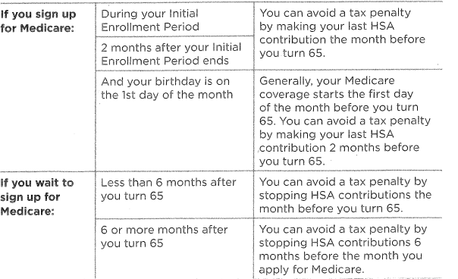
When To Stop Contributing to an HSA
Source: Medicare and You 2026 Page 20
Notes:
High-deductible health plans
In order to qualify to put money into an HSA, you must:
be enrolled in a high-deductible health plan and
may not have any other health insurance (including Medicare or coverage from a spouse or family member).
HDHPs have large deductibles that members must meet before receiving coverage. This means HDHP members pay in full for most health care services until they reach their deductible for the year. Afterwards, the HDHP covers all the member’s costs for the remainder of the year.
Enrolling in Medicare when you have an HSA
If you enroll in Medicare Part A and/or B:
you can no longer contribute pre-tax dollars to your HSA because, with an HSA, you cannot have any health insurance other than an HDHP.
The month your Medicare begins, you should stop contributing to your HSA.
However, you may continue to withdraw money from your HSA after you enroll in Medicare to help pay for medical expenses, such as deductibles, premiums, copayments, and coinsurances.
If you use the account for qualified medical expenses, its funds will continue to be tax-free.
Whether you should delay enrollment in Medicare so you can continue contributing to your HSA depends on your circumstances.
Health coverage from an employer with 20 or more employees pays primary to Medicare, so you may choose to delay Medicare enrollment if you work at this kind of employer and continue putting funds into your HSA, but you must delay BOTH Medicare Part A and Part B to do so.
Note: In either case, you will be able to enroll in Part A and will have access to the Part B Special Enrollment Period (SEP) when you lose coverage or retire.
If you choose to delay Medicare Part A and Part B enrollment because you are still working and want to continue contributing to your HSA, you must also wait to collect Social Security retirement benefits. This is because most individuals who are collecting Social Security benefits when they become eligible for Medicare are automatically enrolled into Medicare Part A. You cannot decline Part A while collecting Social Security benefits.
The takeaway here is that you should delay Social Security benefits and decline Part A if you wish to continue contributing funds to your HSA.
Finally, if you decide to delay enrolling in Medicare, make sure to stop contributing to your HSA at least six months before you do plan to enroll in Medicare. This is because when you enroll in Medicare Part A, you receive up to six months of retroactive coverage, not going back farther than your initial month of eligibility. If you do not stop HSA contributions at least six months before Medicare enrollment, you may incur a tax penalty.
If you require counseling around HSAs, consult a tax professional.

Slide 30

Income Related Medicare Adjustment Amount (IRMAA)
Beneficiaries with significant income will pay a sliding scale higher Part B & D premiums (based on IRS tax returns from 2 years prior)
There are 6 income categories
Each category has a set dollar amount associated with it
Notes:
IRMAA can always be appealed if your current income is less than what IRMAA is based on
Instructions for IRMAA should be located on your Social Security Statement or your IRMAA bill if you aren’t taking Social Security yet.

Slide 31
2026 IRMAA
Single | Married Filing Jointly | Married Filing Separately | Part B Premium + IRMAA | Part D IRMAA
$109,000 or less | $218,00 or less | $109,00 or less | $202.90 | $0 + your plan premium (pp)
$109,001-$137,000 | $218,001-$274,000 | N/A | $284.10 | $14.50 + pp
$137,001-$171,000 | $274,001-342,000 | N/A | $405.80 | $37.50 + pp
$171,001-$205,000 | 3442,001-$410,000 | N/A | $527.50 | $60.40 + pp
$205,001- <$500,00 | $410,001-<$750,000 | >$109,000 and <$391,000 | $649.20 | $83.30 + pp
$500,000 or above | $750,000 or above | $391,000 or above | $689.90 | $91.00 + pp

Slide 32
Help For People With Limited Income and/or Resources
Extra Help (with prescription drugs)
Medicaid
Medicare Savings Programs
Pharmaceutical Assistance Programs*
Prescription** Savings Cards
*Not necessarily income dependent

Slide 33
Enroll on Time!
There are life-long penalties that will follow you if you miss the deadlines for Part D and/or B.
Part B Late Enrollment Penalty is 10% of the Standard Monthly Premium for each full year you should have enrolled but didn’t
So, if you should have enrolled in October of 2023, and decide to enroll during the General Enrollment Period in January of 2026, you will pay $20.90 on top of your Part B Premium
As the Premium changes (generally goes up) every year, so will the amount you pay as a penalty
Part D Late Enrollment Penalty Calculation: Penalty is calculated as 1% of the Part D base beneficiary premium ($38.99 in 2026),
For each month a beneficiary does not have creditable coverage and is not enrolled in Part- D (approximately $0.39 a month x the number of months, added to the monthly premium)
The penalty amount changes each year as the Part D base beneficiary premium changes
Notes:
For Part B penalties, they are calculated from a FULL YEAR, so if you are 1 year and 11 months late in enrolling, your penalty is calculated from 1 year (12 months). If one is 25 months late, the penalty is calculated at 2 years (24 months)
If you don’t sign up for Part D for 5 years, you will now have an additional $4.32 a year added on to your Part D premium, x 5 years, which would be $21.60 a month added on top of whatever premium your plan is charging.
Something we frequently hear is that “I must sign-up when I turn 65 or I will have penalties.” This is basically true, but there are other times people can enroll, depending on their circumstances. A quick conversation with a MMAP counselor can provide you with information on your specific situation.

Slide 34
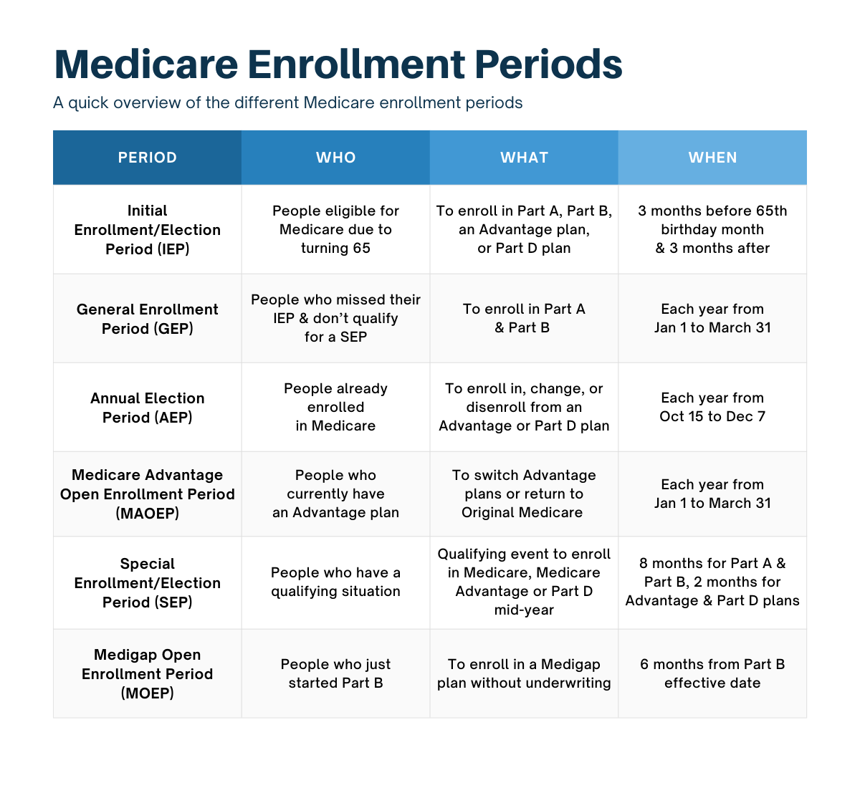
Medicare.gov/basics/get-started-with-medicare
Notes:
This slide details the different enrollment periods for Medicare.

Slide 35

Special Enrollment Periods (SEPs)
Enable beneficiaries to make Part D changes in special situations, including:
Involuntary loss of creditable coverage
Entering, residing in or leaving a long-term care facility
Moving
Other exceptional circumstances
Automatic enrollment into a plan by Medicare
Error by a Federal Employee or SHIP Counselor
First year trial period for Medicare Advantage
Switching to/from PACE (Program of All-Inclusive Care for the Elderly)
When an employer group health plan would otherwise allow a beneficiary to make changes to his/her employer group health plan.
NOTE: COBRA is not considered creditable coverage for Medicare Part B. You may qualify for a Part D Special Enrollment Period, but not in all cases.
Notes:
There are some circumstances in which people with Medicare are given a Special Enrollment Period (SEP).
NOTE on loss of creditable coverage: A beneficiary is not entitled to a SEP if he/she loses coverage due to non-payment of premiums. If a beneficiary was not adequately informed that his/her coverage was not creditable, or that his/her current coverage was reduced so that it is no longer creditable, then the beneficiary will qualify for a SEP.
Other special enrollment circumstances:
There may be reasons why you should take Medicare drug coverage instead of, or in addition to, COBRA. If you take COBRA and it includes creditable prescription drug coverage, you'll have a special enrollment period to join a Medicare drug plan without a penalty when COBRA ends.
Contact us if you thing you might qualify for an SEP. We will help you figure it out.

Slide 36
Medicare Plan Finder Star Rating System
Part D plan rating categories:
Drug plan customer service
Member complaints, problems getting services, and choosing to leave the plan
Member experience with the drug plan
Drug pricing and patient safety
Medicare Advantage Plans rating categories:
Staying healthy: screenings, tests, and vaccines
Managing chronic (long-term) conditions
Plan responsiveness and care
Member complaints, problems getting services, and choosing to leave the plan
Health plan customer service
Notes:
Medicare uses a Star Rating System to measure how well Medicare Advantage and Part D plans perform. Medicare scores how well plans perform in several categories, including quality of care and customer service. Ratings range from one to five stars, with five being the highest and one being the lowest. Plans are rated in each individual category. Medicare also assigns plans one overall star rating to summarize the plan’s performance as a whole. A beneficiary can use the overall star rating to compare performance among several different plans.
Medicare reviews plan performance yearly and releases new star ratings each fall. This means plan ratings may change from year to year.
Remember: Before considering a plan’s star rating, make sure the plan’s coverage and costs suit youe needs. For example, if if are considering a Part D plan, be sure the plan covers their drugs at a cost that works for them.
In an effort to promote better plan quality and better choice, Medicare will be sending notices to those who are in a Part D drug plan or Medicare Advantage health plan that fails to get at least a 3-star quality rating for three straight years. The notice lets them know about a Special Enrollment Period to enroll in a 4- or 5-star plan. If you get such a notice and want to consider a new plan, feel free to call us. We provide counseling all year round.

Slide 37

Annual Notice of Plan Changes
Plan Annual Notice of Change (ANOC)
Part D and Medicare Advantage Plans can change their benefits and costs annually
Be sure to check
Premium, deductible, co-payment changes
Are your drugs still covered?
Are your drugs still covered at the same tier?
Are there restrictions to your drugs?
Is there another Plan that offers better coverage?
Notes:
You should have received your current Medicare plan’s Annual Notice of Change in September, if you haven’t received it look for an envelope from your insurance provider and note that it may be on thinner paper.
Note: Plans cannot change coverage midyear

Slide 38
Marketing Guidelines | Medicare Advantage and Part D Plans CANNOT:
Solicit door-to-door
Call people on national and state “do not call” lists*
Enroll people over the phone during a solicitation call
Offer incentives or gifts exceeding $15, or offer a meal
Engage in activities to mislead or confuse
Conduct sales presentations or collect enrollment information at health fairs or educational events
Notes:
Plans may not discriminate based on race, ethnicity, national origin, religion, gender, sex, age, mental or physical disability, health status, receipt of health care, claims experience, medical history, genetic information, evidence or insurability, or geographic location. They cannot target Higher Income Areas. They cannot state or imply that plans are only available to Senior rather than all Medicare beneficiaries, or use the term “Free” to describe: Zero dollar premium or Reduction in premiums including the part b buy-down or give-back, reduction in deductibles for cost-sharing
Marketers must clearly indicate what plans/companies they are representing. And, also note that there is a 12 hour break between a marketing event and a sales event, meaning that if you attend a marketing/educational event and like what you see, the presenter cannot sell you a policy on the spot. There must be a 12 hour break between sessions. And what is going to be discussed must be filled out on a scope of appointment form
Plans must include the plan type at the end of each plan name on all communication materials, including marketing material, when the plan name is mentioned.
If you feel you have witnessed a marketing violation or have been misled by a marketer, call us with as much information as you have. We can help.

Slide 39



Third Party Marketing Organizations Must Include Disclaimers on TV/Radio and Social Media Ads
Example:
“We do not offer every plan available in your area. Currently we represent [number of organizations] organizations which offer [number of plans] products in your area. Please contact Medicare.gov, 1-800-MEDICARE, or your local State Health Insurance Program (SHIP) to get information on all of your options.
“Currently we represent [number of organizations] organizations which offer [number of plans] products in your area. You can always contact Medicare.gov, 1-800-MEDICARE or your local State Health Insurance Program for help with plan choices.”
Notes:
Third party marketers are, for example the commercials you see with Captain Kirk, Jimmy Walker or Joe Nameth urging you to call and enroll in a plan.
They must have a disclaimer on their ads, however, there is no rule on how fast they can read it.
This slide shows a couple examples of disclaimers that marketers can use. Please note that they need to reference the state SHIP programs!
Please be very mindful if you choose to call the numbers they provide. More than one medicare beneficiary has found themselves enrolled in a plan they did not care to be on. If you hear something that sounds really good, call us and let us know what you are interested in. We will do our best to find you a plan with those benefits.

Slide 40

Medicare Preventive Services
Find problems early, when treatment works best. These are covered by:
Medicare Part B
Original Medicare: Pay nothing for most preventive services from a provider who accepts assignment
May require copayment/coinsurance for office visit
May pay more from provider who does not accept assignment
Medicare Advantage and other plans
May require copayments/coinsurances depending on plan benefits
Notes:
Medicare Part B covers preventive services like screening exams, wellness visits, lab tests, and immunizations to help prevent, find, and manage medical problems.
Preventive services may find health problems early, when treatment works best.
You must have Medicare Part B for Medicare to cover these services. These services are covered no matter what kind of Medicare health plan you have. However, the rules for how much you pay for these services may vary. Talk with your doctor about which preventive services you need, how often you need them to stay healthy, and if you meet the criteria for coverage based on your age, gender, and medical history.
The Medicare & You Handbook, Product Number 10050-50, (year 2023 pages 30- 54) for a list of common Part B-covered services and includes guidelines for who is covered and how often Medicare will pay for these services.

Slide 41

“Welcome to Medicare” Visit
One-time visit covered within first 12 months of enrolling in Part B.
Includes:
Review of medical and social history
Height, weight and body mass index
Simple vision test
Education and counseling
Doctor may refer you for additional screenings
Notes:
The “Welcome to Medicare” visit is a great way to get up-to-date on important screenings and shots and to review your medical history.
The “Welcome to Medicare” visit is only offered within the first 12 months of getting Medicare Part B.
During the exam, your doctor will review the following.
Your medical and social history
Height, weight, body mass index, blood pressure, and give you a simple vision test
Potential (risk factors) for depression
Review of functional ability and level of safety, which means an assessment of:
Hearing impairment
Ability to successfully perform activities of daily living
Fall risk, and
Home safety
You will get advice to help you prevent disease, improve your health, and stay well. You will also get a brief written plan (like a checklist), letting you know which screenings and other preventive services you need.
Your doctor may also refer you for additional Medicare-covered screenings if you receive the referral as a result of your initial “Welcome to Medicare” visit.
There is no cost if your doctor accepts Medicare assignment.

Slide 42

Yearly Wellness Visit
Available every 12 months and includes:
Personalized prevention plan
Routine Measurements
Health advice just for you
Review of medical and family history
Review of current prescriptions
Advance care planning
Cognitive assessment
Referrals for health education and preventive counseling
Notes:
Medicare covers a yearly wellness visit.
After you’ve had Part B for longer than 12 months, you can get an yearly wellness visit to develop or update a prevention plan just for you. Medicare covers this visit once every 12 months.
During the visit, your doctor will:
Ask you to fill out a questionnaire, Called a “Health risk Assessment”
Routine measurements,
Routine health advice
Review of your medical and family history.
Review of your current prescriptions
Advance care planning
Perform a cognitive assessment looking for signs of dementia, Alzheimer’s disease, cognitive impairment.
Evaluate your potential risk factors for substance use disorder if you use opioid medications.
Give you advice to help you prevent disease, improve your health, and stay well. You will get a brief written plan, like a checklist, letting you know which screenings and other preventive services you need over the next 5 to 10 years.
You don’t need to get the “Welcome to Medicare Visit” before getting an annual wellness visit.
If you choose to get the “Welcome to Medicare Visit,” you’ll have to wait 12 months before you can get your first annual wellness visit.
You’ll pay nothing for this exam if the doctor accepts assignment.

Slide 43
Wellness and Preventive Services
Service​ | How Often​ | Your Cost​
Cardiovascular disease screenings​ | Every 5 Years​ | No cost for the tests. ​ 20% for doctor’s visit​
Mammograms​ | Every 12 months for women 40 years of age and older​ | No cost​
Colorectal Cancer Screening ​ Colonoscopy​ | Every 120 months​ Every 24 months if high risk​ | No cost for test. ​ 20% for doctor’s visit or hospital copay​
Prostate cancer screenings​ | Every 12 months for men over 50 year of age​ | No cost for PSA test​ 20% for doctor’s visit or hospital copay​
Flu shot​ | One shot per season​ | No cost​
Pneumococcal shot​ | Most people only need once/lifetime​ | No Cost ​
Bone mass measurement ​ | Every 24 months​ | No cost​
Glaucoma tests | Every 12 months if you are high risk | 20% for doctor’s visit or hospital copay
Diabetes Screening | Up to 2 blood glucose laboratory test screenings each year | No cost
Pap tests/Pelvic exams | Every 24 months Every 12 months if high risk | No cost
HIV (Human Immunodeficiency Virus) screening | Every 12 months Between 15-65 years old Younger than 15 older than 65 and at an increased risk Up to 3 times during a pregnancy | No cost
Covid vaccines | As recommended by the CDC guidelines | No cost (this could change when the public health emergency ends)
Shingles Vaccine | Adults 50 years and older two doses two to six months apart | No deductible and no cost-sharing with Part D coverage
Tetanus – Diphtheria – Whooping Cough Vaccines | Can be given at any time and followed by a Td or Tdap shot every 10 years | No cost
Notes:
In addition to the “Welcome to Medicare” Visit and Yearly Medicare visit, Medicare covers several other preventive and wellness services. This slide details some of the Wellness and Preventive Services covered by Medicare. The 20% coinsurance would apply after the annual Part B deductible is met (2023 Part B annual deductible is $226)
Cardiovascular disease screenings – these screenings include blood test for cholesterol, lipid, and triglyceride levels to help detect conditions that may lead to a heart attack or stroke.
Mammograms – screening to check for breast cancer.
Colonoscopy – screening to help find precancerous growths.
Prostate cancer screening – covers both digital rectal exams and prostate specific antigen (PSA) tests
Flu shot – Medicare covers one flu shot (or vaccine) per flu season. Helps prevent the flu
Pneumococcal shot – helps prevent certain types of pneumonia. Medicare will cover a single dose vaccine in addition to a 2-dose series. Talk to your doctor or health care provider to see which vaccine you should get.
Bone mass measurement – screening to see if you’re at risk for broken bones.

Slide 44

A Few Words About Fraud and Scams
Medicare Fraud is the most common scheme affecting seniors. Some examples include:
Medicare/Medicaid is billed for services you never received, equipment you never received or was returned
Someone uses your Medicare/Medicaid card
A company uses false information to mislead you into joining a Medicare plan
Calls asking to verify your Medicare # so you can get a plastic card
Calls offering you rebates on certain services
Calls indicating that your Medicare plan is being terminated
Calls offering you a wellness exam (and they will notify your doctor)
Many times the caller will be insistent on immediate action or payment and these calls can be quite scary.
Notes:
Be Alert!
For example - There are health care services, not associated with your primary care provider, who offer to conduct your Welcome to Medicare Visit or a Yearly Wellness Visit and says they will send the results to your primary care provider.
They use direct mailings and ads to try and get your business. Their approach may be to tell you that these types of visits are their specialty, and your doctor doesn’t do them or won’t do them. Which is not true!
And they are at no cost to you, your insurance/Medicare will cover this, they will be happy to provide the service.
Medicare's- Welcome to Medicare and Yearly Wellness visits were intended to facilitate communication and planning between you and your primary health care provider

Slide 45
Medicare Fraud
Be sure to review your Medicare Summary Notices (MSN) if you have Original Medicare, or your Explanation of Benefits (EOB) if you have a PPO or HMO, on a regular basis
You may see charges for services services or equipment that are charged to Medicare.
Even if you don’t have to pay for them, Medicare does
If you see such charges, contact your provider’s billing department. It could simply be the wrong code entered
If you see a pattern, or for example, multiple wrong charges on the same MSN or EOB, chances are it is fraud—especially if you are not responsible for the bill

Slide 46
To Report Fraud or Scams
Michigan SMP Hotline: (844)677-6424
Senior Medicare Patrol Program: MDHHS-SMP@Michigan.gov
Outside of Michigan: (877) 808-2468 SMPResource.org
Do not be afraid or embarrassed to report if you have been a victim of a scam. The scammers are very tricky! It can happen to anyone.

Slide 47
How Can A MI Options Medicare Counselor Help You
Understand Medicare health plans
01
Compare and enroll in Medicare Advantage Coverage
02
Compare or enroll in Medicare Prescription Drug Coverage
03
Identify and report Medicare and Medicaid fraud and scams
04
Assist with enrollment into low-income programs
05
Notes:
MMAP counselors can:
Help you understand Medicare health plans
Compare and enroll you in Medicare Advantage Coverage
Compare and enroll you in Medicare Prescription Drug Coverage
Help you identify and report Medicare and Medicaid fraud and scams
Assist you with enrollment into low-income programs like Extra Help and Medicaid
Help with appeal and bill questions

Slide 48
We Are Here to Help You
If you want to speak with a counselor about your specific situation, give us a call
Our service is confidential and unbiased
We counsel currently over the phone, Teams and in-person where available
No question is too trivial, and we often deal with very complicated questions as well
There are various options for counseling: In person, Microsoft Teams, or Telephone. Call us today at 248-262-0545. We serve Livingston, Macomb, Monroe, Oakland, St. Clair and Washtenaw Counties.
For SHIP Counseling outside of Michigan, call the MI Options Medicare Counseling at 800-803-7174 or visit www.eldercare.acl.gov.
Notes:
Leave a message on our voice mail if no one answers.
We run primarily on part-time staff, but someone will get back to you within a day or two.

Slide 49
For More Information
Contact us at SHIP@ageways.org or 248-262-0545
Visit Medicare.gov
Browse the Medicare & You Handbook
Call 1-800-MEDICARE
MI Options Medicare Counseling elsewhere in Michigan-800-803-7174
SHIP Counseling outside of Michigan www.SHIPhelp.org
Notes:
For resources outside of MMAP there is The Medicare & You book which is state specific, showing specific plans for MI. You receive a hard copy each fall but can access an electronic version all year online.
Medicare.gov is Medicare’s Plan Finder and Medicare's website and of course you can call 1-800-Medicare as well.
However, the best resource for your local Medicare information is MMAP. Our services are free and unbiased. Our certified counselors are not sales agents and not affiliated with private insurance companies. We can be your best resource for all questions and concerns Medicare. No question is too small or difficult. We have saved over $2 million for beneficiaries in your area.

Slide 50

Satisfaction Survey
This survey is part of a larger analysis of our national program.
It is completely confidential
It is also anonymous
Your participation is voluntary
It takes less than 5 mins to complete
Survey Link:
https://www.surveymonkey.com/r/ACLED
Notes:
At this time, I’d like to give you the option to complete a satisfaction survey. This survey was developed to be part of a larger analysis of our national program. I did not create the survey and I will not see any of your responses. This survey is completely voluntary and should take less than five minutes to complete. It is also anonymous – you are not required to include any personal information, such as name, date of birth, or location.
If you would like to participate, please scan this QR Code now. If you provide your email address, I will send you an email with the survey link as well.
Thank you. Let me know if you have any questions.
Survey Link: https://www.surveymonkey.com/r/ACLED

Slide 51
Funding Statement
This program is supported by the Administration for Community Living (ACL), U.S. Department of Health and Human Services (HHS) as part of a financial assistance award totaling $185,425 with 100 percentage funded by ACL/HHS. The contents are those of the author(s) and do not necessarily represent the official views of, nor an endorsement, by ACL/HHS, or the U.S. Government.

